Slide 1

DIGITAL IMAGE PROCESSING
MINI-PROJECT

Slide 2

HANDWRITTEN TEXT RECOGNITION

Slide 3
V Shashank
PREPARED BY

Slide 4
TABLE OF CONTENTS
INTRODUCTION
OCR & HTR
UNDERLYING CODE
WORKING

Slide 5
INTRODUCTION

Slide 6
ABOUT THE PROJECT
Handwritten Text Recognition (HTR) system implemented with TensorFlow (TF) and trained on the IAM off-line HTR dataset. The model takes images of single words or text lines (multiple words) as input and outputs the recognized text. 3/4 of the words from the validation-set are correctly recognized, and the character error rate is around 10%.

Slide 7




ABOUT THE PROJECT
Project Prerequisites
Python (3.7.4 used)
IDE (Jupyter used)
Required frameworks are
NumPy (version 1.16.5)
cv2 (OpenCV) (version 3.4.2)
Keras (version 2.3.1)
TensorFlow (Keras uses TensorFlow in backend and for some image pre-processing) (version 2.0.0)
Matplotlib (version 3.1.1)
Pandas (version 0.25.1)

Slide 8
OCR & HTR

Slide 9
OPTICAL CHARACTER RECOGNITION
Optical character recognition (OCR) is a process of converting images of typed, handwritten, or printed text into machine-encoded text. OCR is widely used to convert books and documents into electronic format, to digitize printed documents, to recognize text from images, and to make text searchable and machine-readable. However, the disadvantages of optical character recognition are many. Handwriting recognition tends to be significantly harder than traditional OCR that uses specific fonts/characters.
The reason this concept is so challenging is that unlike computer fonts, there are nearly infinite variations of handwriting styles. Every one of us has a personal style that is specific and unique.

Slide 10
DISADVANTAGES WITH OCR
Quality is not always high
Sometimes inaccurate
This is because OCR technology is not 100% accurate, and it can sometimes make mistakes when converting images to text.
The quality of OCR depends on the quality of input image that is provided to it.
Time consuming and expensive
Lack of info on some characters
One of the problems associated with optical character recognition is a lack of information on some characters, such as punctuation.
OCR technology has to analyze each image and convert it into text, which can take some time.

Slide 11




SOLUTION THROUGH HTR
Better Customer Service
Improved Accessibility
Better Data Storage
More Flexibility
Can convert handwritten data into digital format, which can save space, reduce paper waste, and facilitate data backup and retrieval
Can handle different styles and sizes of text, as well as neat handwriting, which may not be easily recognized by OCR. Also work with different languages and scripts
Can enable faster and more accurate processing of handwritten forms, such as surveys, feedback, or applications
Can help blind and visually impaired individuals by converting handwritten text into speech, using OCR technology

Slide 12
UNDERLYING CODE

Slide 13
NECESSARY IMPORTS
import matplotlib.pyplot as plt
import cv2
import numpy as np
from keras.models import Sequential
from keras.layers import Dense, Flatten, Conv2D, MaxPool2D, Dropout
from keras.optimizers import SGD, Adam
from keras.activations import relu, sigmoid, softmax
import keras.backend as K
from keras.utils import to_categorical
import pandas as pd
from tensorflow.keras import backend as tf_keras_backend
from keras.models import Sequential

Slide 14
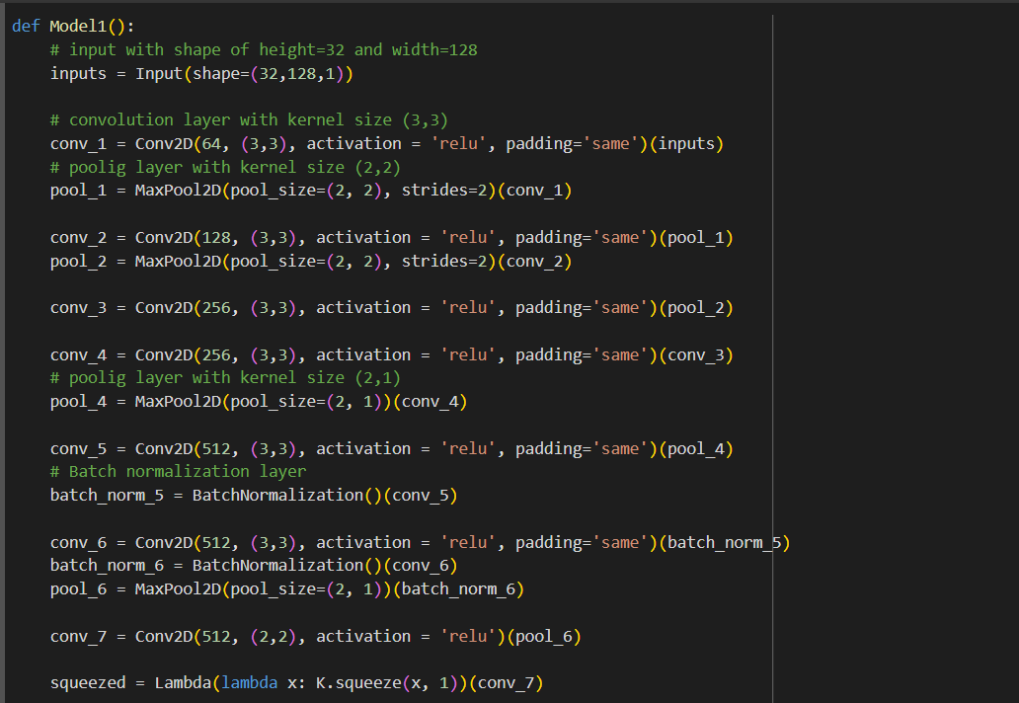



HTR MODEL
MODEL DEFINITION INCLUSIVE OF CONVOLUTIONAL LAYERS AND POOL LAYERS

Slide 15
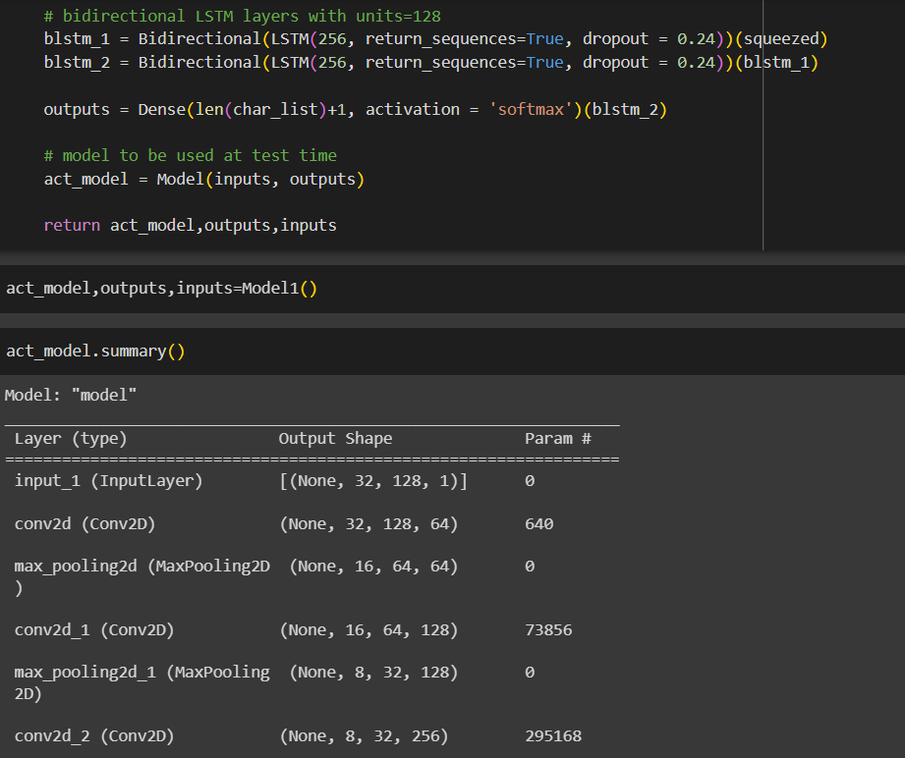
HTR MODEL
FETCHING MODEL SUMMARY
RETURNS THE LAYER TYPE, OUTPUT SHAPE AND PARAMETER

Slide 16
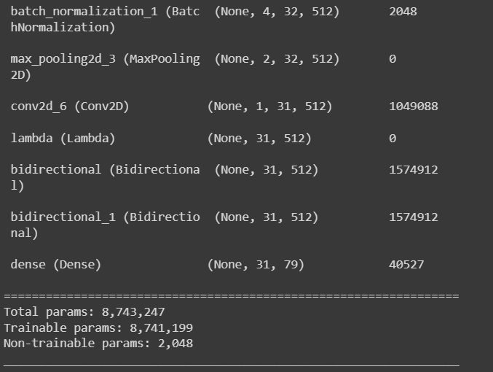
MODEL SUMMARY
SUMMARY OF THE MODEL INCLUDING THE TOTAL AVAILABLE PARAMETERS, AMOUNT OF PARAMETERS THAT ARE TRAINABLE AND NON-TRAINABLE

Slide 17
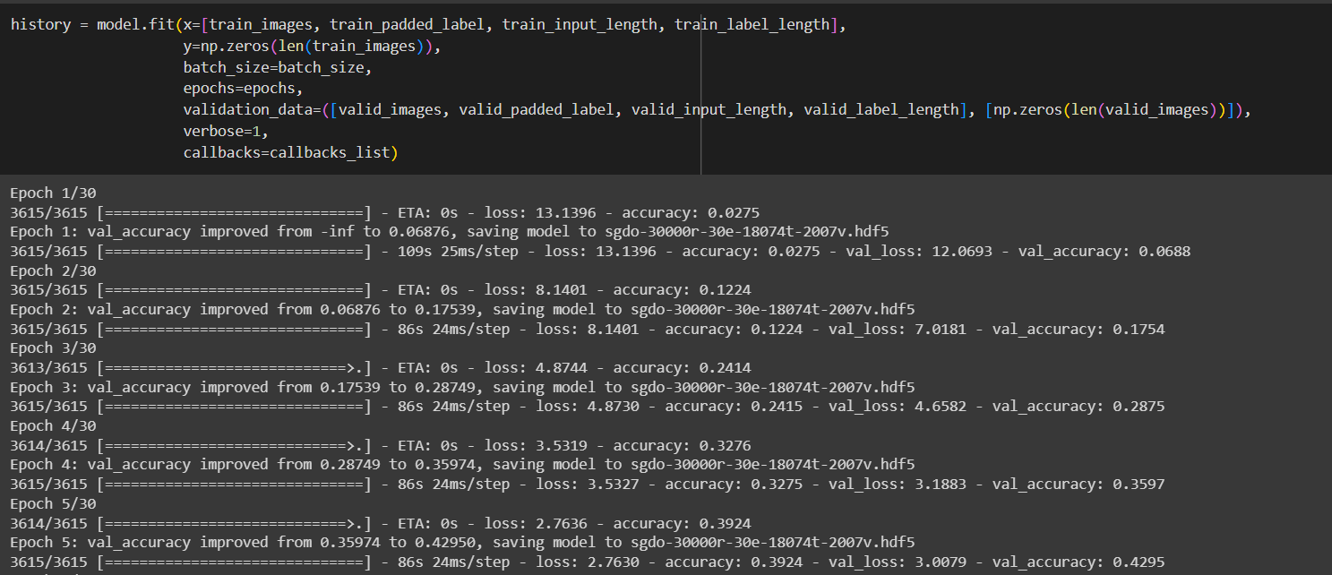
TRAINING HTR MODEL
SPECIFYING VALIDATION ACCURACY AND LOSS

Slide 18
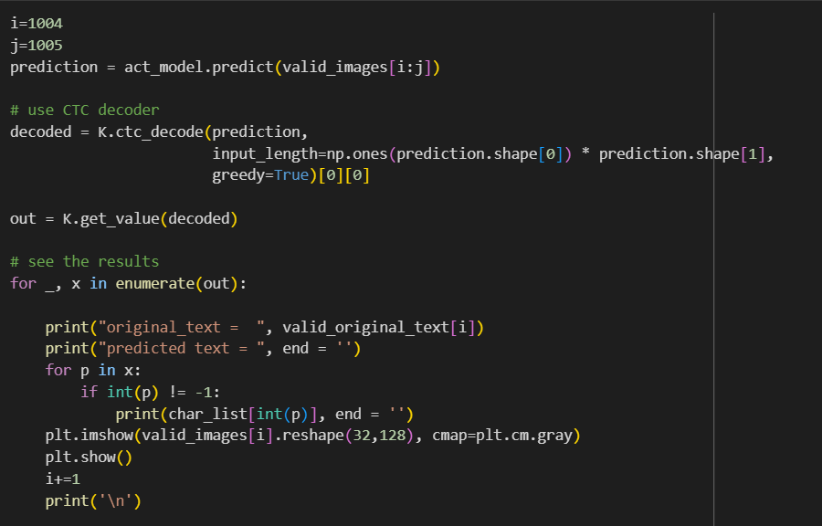
CHOOSING TEXT IMAGES
SPECIFYING THE IMAGES TO BE CHOSEN AND DISPLAYED ON A GRAPH, WITHIN THE PLOTTED GRID

Slide 19
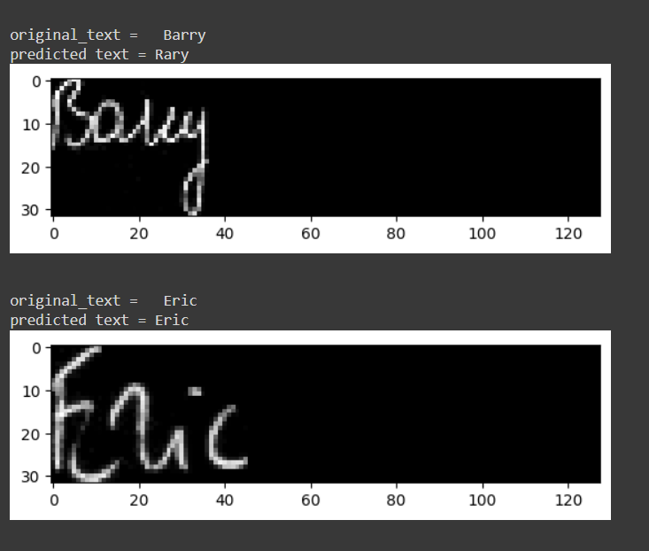
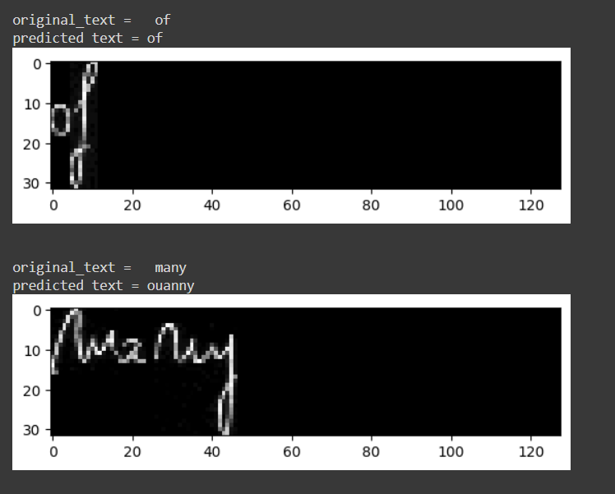
DISPLAYED OUTPUT

Slide 20
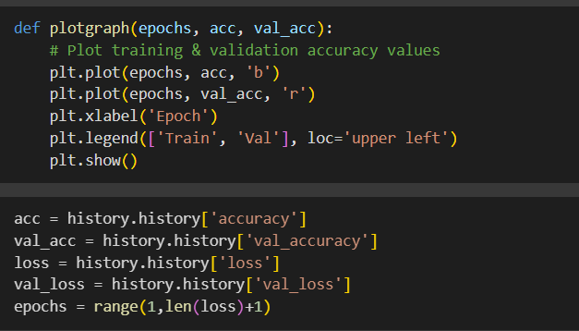
PLOT GRAPH
SPECIFY THE X AND Y CO-ORDINATES FOR PLOTTING THE GRAPH INDICATING THE VALIDATION AND TRAIINING ACCURACY

Slide 21
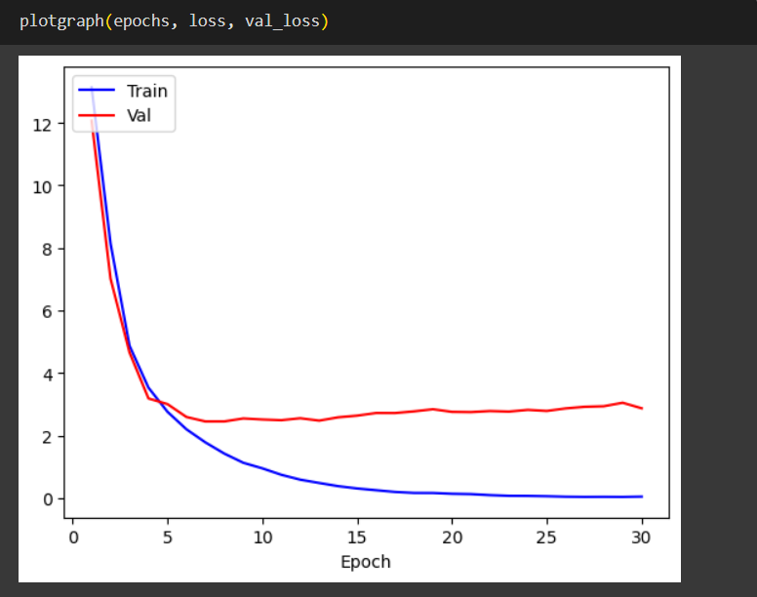
PLOT GRAPH
GRAPH SHOWCASING THE TRAINING LOSS AND VALIDATION LOSS AS BLUE AND RED LINES RESPECTIVELY

Slide 22
WORKING

Slide 23
WHAT IS CNN?
CNN stands for Convolutional Neural Networks that are used to extract the features of the images using several layers of filters. In terms of handwriting recognition, CNN can be used to extract visual features from handwritten characters or words and classify them into corresponding labels.
A convolutional layer applies a set of filters to the input data and produces a set of feature maps. An activation layer applies a nonlinear function to the feature maps to introduce nonlinearity and sparsity. A pooling layer reduces the size and complexity of the feature maps by applying a down sampling operation such as max-pooling or average-pooling. The output layer is usually a fully connected layer that performs the final classification or regression task.

Slide 24
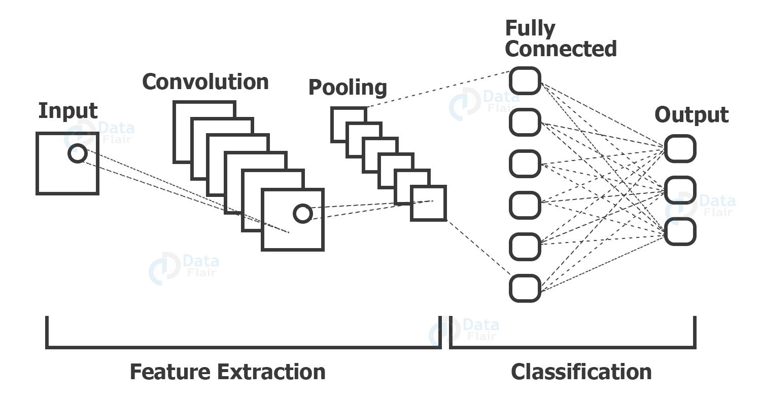
CNN MODEL
The convolution layers are generally followed by maxpool layers that are used to reduce the number of features extracted and ultimately the output of the maxpool and layers and convolution layers are flattened into a vector of single dimension and are given as an input to the Dense layer (The fully connected network).

Slide 25



PROJECT IMPLEMENTATION
The project can be implemented through Google Colab or through Visual Studio.
The demo to be presented will be done using Google Colab, which will require a stable internet connection to execute each cell of code.
Project is saved and shared as a .ipynb file and is a python notebook file which requires multiple libraries and packages to be pre-installed on the device used to run the project.

Slide 26


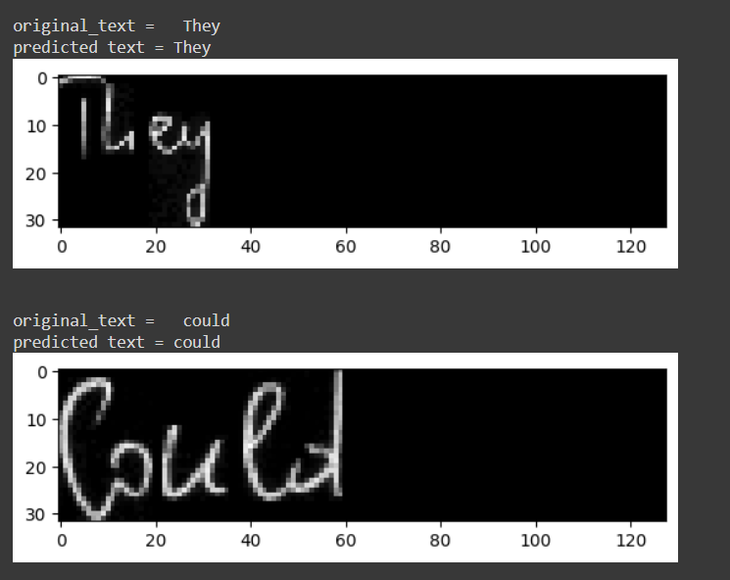
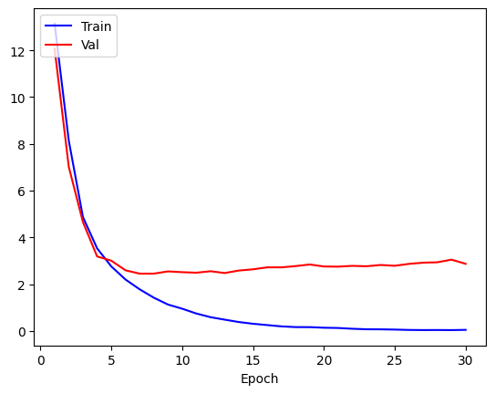
OUTCOME OF PROJECT
Doing Some Predictions on Test Data
SELECT THE PARTICULAR SET OF WORDS FROM THE CSV FILE AND IDENTIFY THE TEXT BY COMPARING THE ORIGINAL TEXT WITH THE PREDICTED TEXT AND PLOT THE TRAINING AND VALIDATION LOSS ON A GRAPH

Slide 27
ESTIMATED VALUES
10.6480244994163513
0.605381190776825
0.9407136117587043
0.7503042817115784
Best Loss
Best Accuracy
Best Validation Accuracy
Jaro value

Slide 28
THANK YOU

